Slide 1
Dissertation Proposal Meeting
Sean Duan

Slide 2
Dissertation Proposal Meeting Outline
Introduction
Study 1
Study 2
Proposed Study 3

Slide 3
Introduction
Problem Statement: Changing polarized beliefs has becoming increasingly important because:
Polarization is increasing (political belief, belief in science, etc.)
Polarizing beliefs resulting in negative consequences (vaccine hesitancy, lack of reproductive healthcare, etc.) are difficult to change.

Slide 4
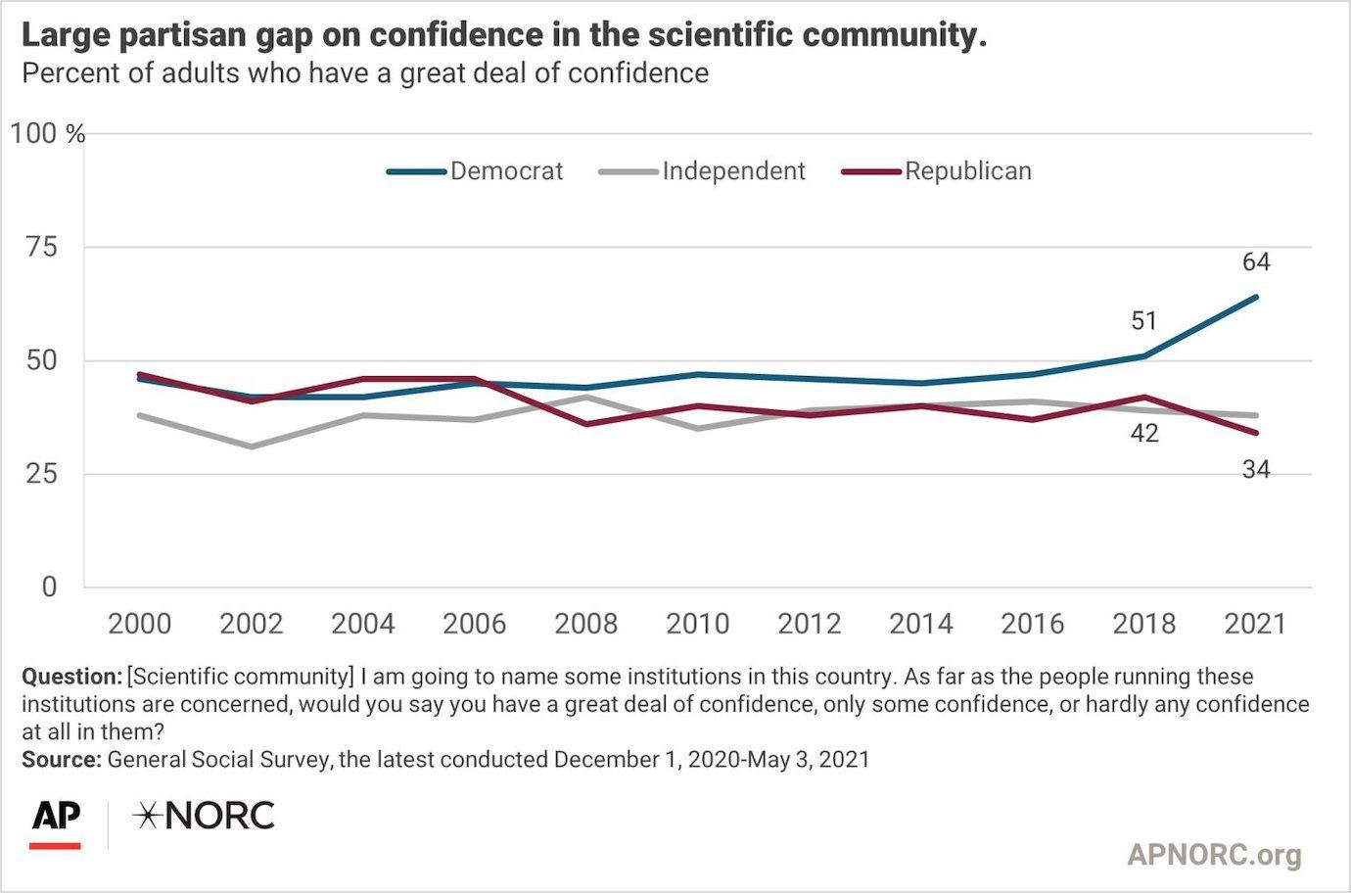

Slide 5
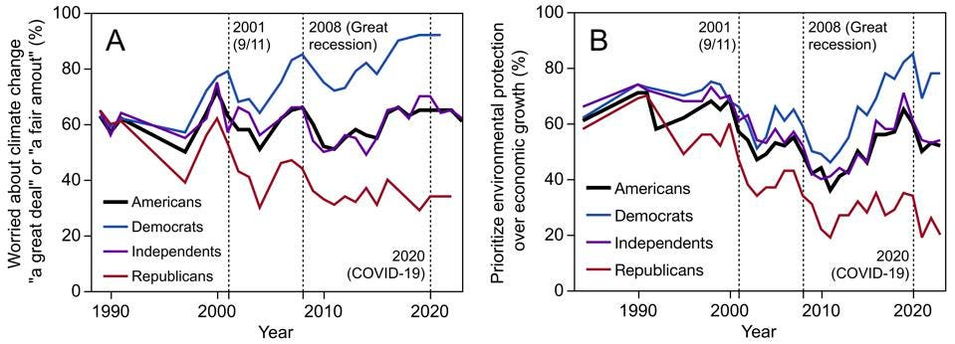

Slide 6

Introduction
Research Question: What are some under-explored processes that affect openness to change for polarized beliefs:
Two main constructs examined
Moral Conviction
Social Consensus

Slide 7
Study 1
Social Memory and Recollection on Current and Past Issues

Slide 8
Participants
Psychology 1000 Students (N = 505)
Age M (SD): 18.9 (1.99)
Preferred gender identity
Female – 63.6%
Male – 33.5%
Gender Variant or Nonconforming – 1.4%
Prefer not to say – 1.6%
Self-Identified race
White – 77%
Black – 5.3%
Hispanic – 6.7%
Asian – 5.1%
Native American – 0.39%
Other – 2.4%
Prefer not to say – 1.6%

Slide 9
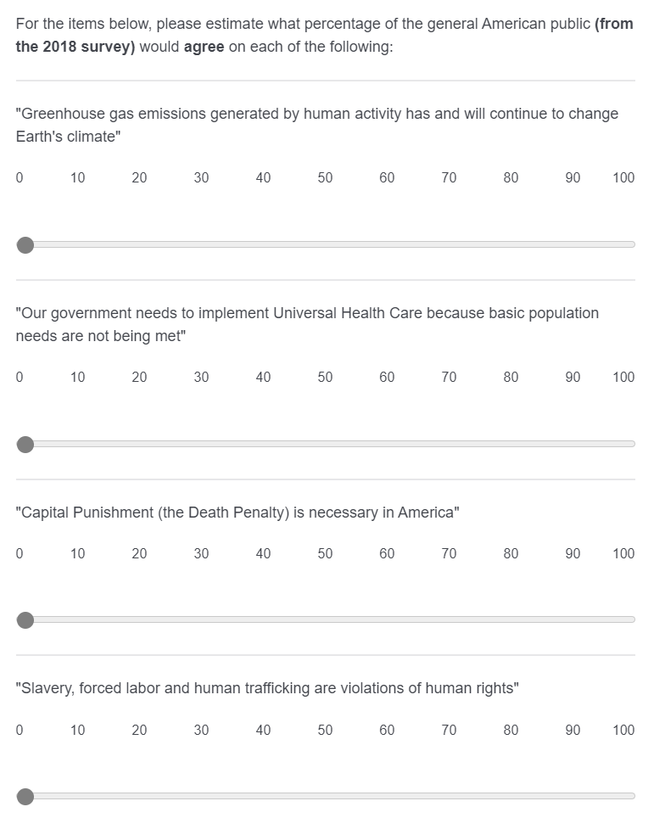
Method

Slide 10
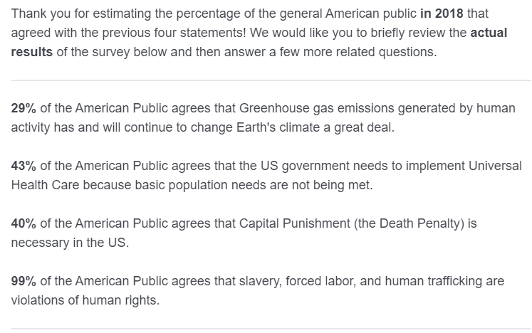
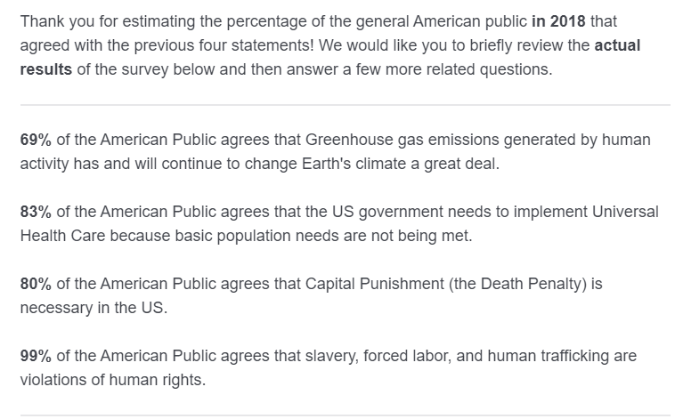
Method
Low social consensus condition
High social consensus condition

Slide 11
Outcomes

Slide 12
Study Design
Repeated measures design
2 Independent Variables:
Time: Before or After consensus manipulation
Social Consensus: Low (-20%) or High (+20%)
2 x 2 design
Participants rated their support for an issue before the manipulation, and after the manipulation – social consensus was between subjects, randomly assigned to low or high.
Measured individual differences: deontological and utilitarian orientation, health literacy, subjective and objective numeracy

Slide 13
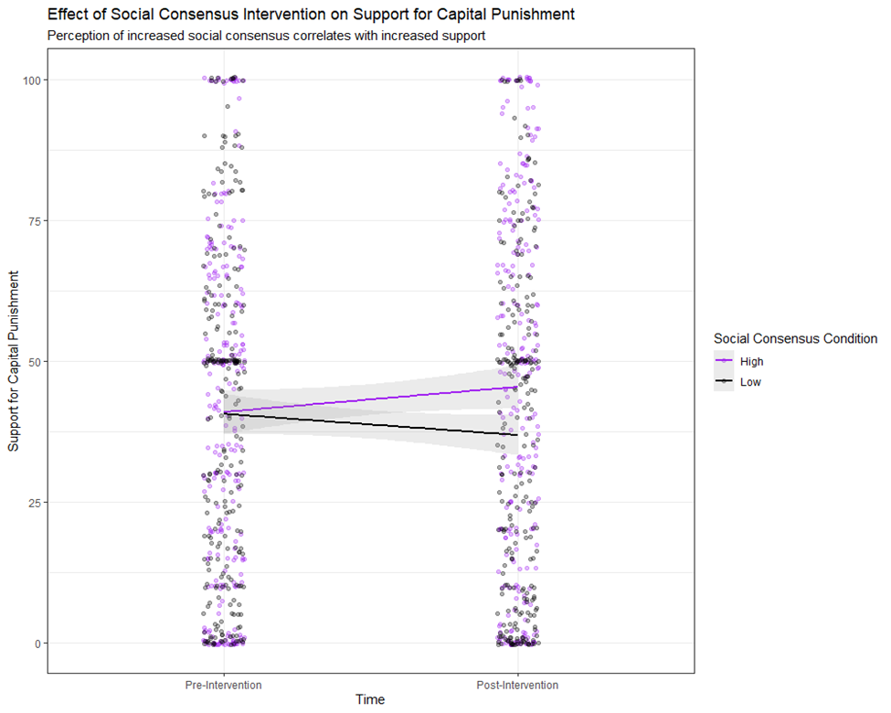
Results

Slide 14
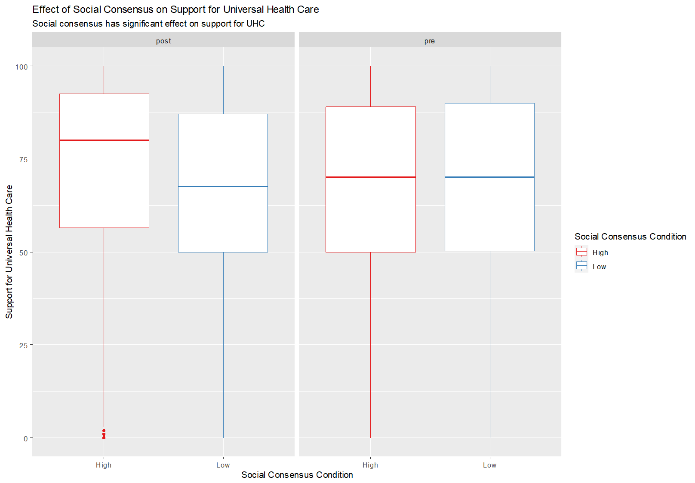
Results

Slide 15
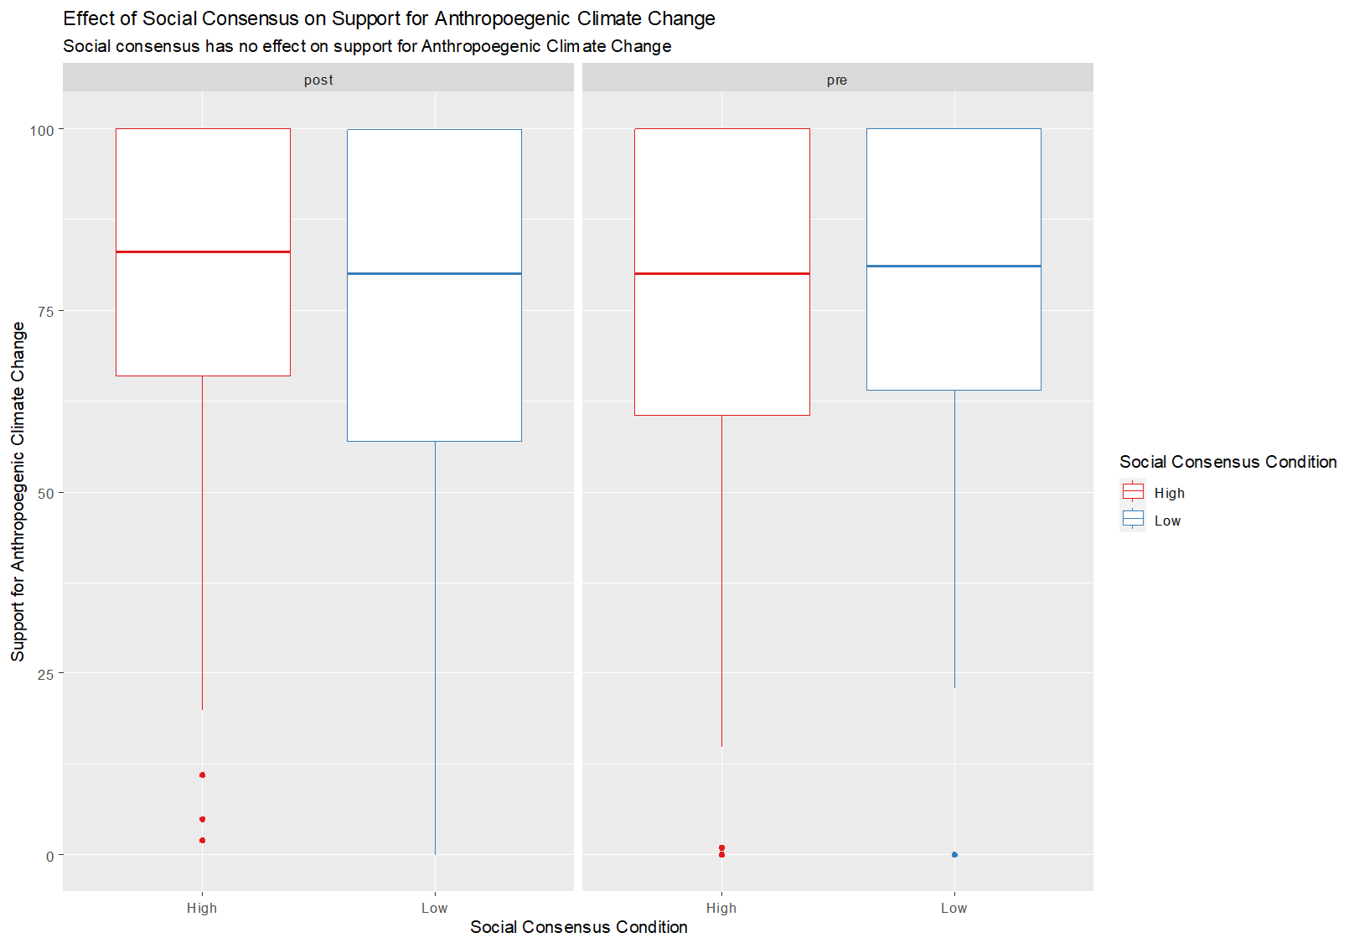
Results

Slide 16
Study 1
Social Memory and Recollection on Current and Past Issues

Slide 17
Participants
Psychology 1000 Students (N = 505)
Age M (SD): 18.9 (1.99)
Preferred gender identity
Female – 63.6%
Male – 33.5%
Gender Variant or Nonconforming – 1.4%
Prefer not to say – 1.6%
Self-Identified race
White – 77%
Black – 5.3%
Hispanic – 6.7%
Asian – 5.1%
Native American – 0.39%
Other – 2.4%
Prefer not to say – 1.6%

Slide 18
Method

Slide 19
Method
Low social consensus condition
High social consensus condition

Slide 20
Outcomes

Slide 21
Study Design
Repeated measures design
2 Independent Variables:
Time: Before or After consensus manipulation
Social Consensus: Low (-20%) or High (+20%)
2 x 2 design
Participants rated their support for an issue before the manipulation, and after the manipulation – social consensus was between subjects, randomly assigned to low or high.
Measured individual differences: deontological and utilitarian orientation, health literacy, subjective and objective numeracy

Slide 22
Results

Slide 23
Results

Slide 24
Results

Slide 25
Conclusion

Slide 26
Study 2
Effect of Moral Conviction on Current and Past Issues

Slide 27
Participants
Psychology 1000 Students (N = 208)
Demographic information was not collected

Slide 28
Method

Slide 29
Method
Low social consensus condition
High social consensus condition

Slide 30
Outcomes

Slide 31
Study Design
Repeated measures design
2 Independent Variables:
Time: Before or After consensus manipulation
Social Consensus: Low (-20%) or High (+20%)
2 x 2 design
Participants rated their support for an issue before the manipulation, and after the manipulation – social consensus was between subjects, randomly assigned to low or high.
Measured individual differences: deontological and utilitarian orientation, health literacy, subjective and objective numeracy

Slide 32
Results

Slide 33
Results

Slide 34
Results

Slide 35
Study 2
Is the design of the intervention appropriate for our proposed experimental manipulation?
If so, does the experiment address a significant portion of our research question?
Do the hypothesis for Study 2 make intuitive sense?
E.g., Do they need to be re-written, or do alternative hypothesis seem more reasonable (and if so, suggestions?)

Slide 36
Study 3
Do we make a reasonable case for the empirical need to examine the joint effect of moral conviction and social consensus, on the novel topic of UHC?
Are these hypothesis reasonable extensions of the work done in Study 1 and 2.
Furthermore, does this interaction feel like it still is addressing the original research question?

Slide 37
Results/Discussion
What type of general structure would you want to see for the results?
Specific requests for data visualization?
What concepts and extensions would you want expanded on in the discussion?
What kinds of limitations are appropriate to address for this study?

